Slide 1
Uintah Basin Anomalous Phenomenon Study Phase 1 Results
By: Jim Segala, Ph.D.

Slide 2
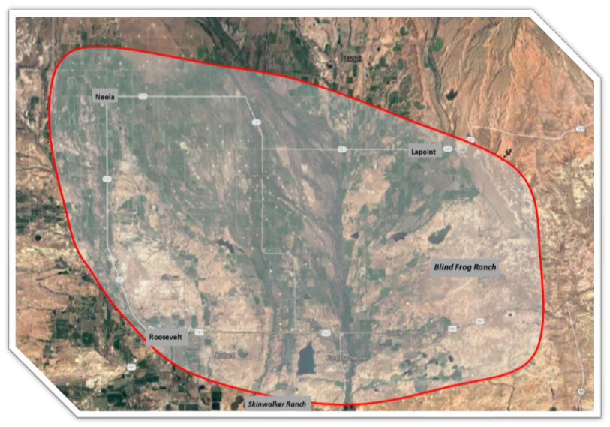
Uintah Basin Unexplained Phenomenon
Unexplained phenomenon has been reported in the Uintah Basin for over 100 years.
Many events were documented in the famous book The Utah UFO Display by Junior Hicks and Frank B. Salisbury.
Evidence shows a high concentration of events in the region enclosed in red.
Many reported medical cases due to bizarre, unexplained injuries have been documented.
Many photographs have been taken of UAP’s.

Slide 3
Uintah Basin Unsolved Injuries
For over 30 years, many unsolved medical cases of patients with strange injuries has been documented.
Eight documented life-threatening injuries occurred over the past five years. Others are known to exist.
In 2019 the Uintah Basin Anomalous Phenomenon Study is initiated.

Slide 4
Uintah Basin Anomalous Phenomenon Study
Record the signals known to arise when unidentified phenomenon occurs and correlate those to human observations in order to gain an understanding of the source.
Started in 2019 by Jim Segala and Michele Meiners with the goal of helping the people in the Unitah Basin understand the phenomenon that they are dealing with day to day.
Install custom environmental recording devices in key locations where unidentified phenomenon is known to occur.
Create a unified network of environmental recording devices throughout the Basin.
Establish a community of participates and provide a rich platform for participants to record their experiences and correlate those to changes in the environmental readings.

Slide 5
Our Success Story
Over the past three years our study has grown to include an extensive collection of enthusiastic participants from the Uintah Basin as well as other areas of the USA where strange phenomenon is known to occur.
Over 3.5 Terabytes of data has been recorded by scientific instruments in the Uintah Basin alone.
Over 600 documented interactions with the phenomenon has been documented by our participants that correlations to environmental readings taken using calibrated scientific instrumentation.
Four high-capacity servers are now online collecting the data for the study.
Statistical accuracy predicting the occurrence of an interaction has grown to over 4.8 sigma.
We continue to add new participates to the study at an increasing rate.

Slide 6
What We Learned So Far
The phenomenon interacts mostly with the people in the Uintah Basin and is not really concentrated in any particular area within in the Basin.
There seems to be a concentration of interactions in the northern section of the Uintah Basin near the Uintah Canyons.
Interactions with the phenomenon can be positive as well and negative.
Treating the phenomenon and land with respect usually leads to a very positive interaction with lower-level recordings on the scientific instruments.
Negative interactions show very defined peaks in the recorded data with pronounced negative effects on the people.
From the real-time data we can now predict when the phenomenon is interacting with someone.

Slide 7
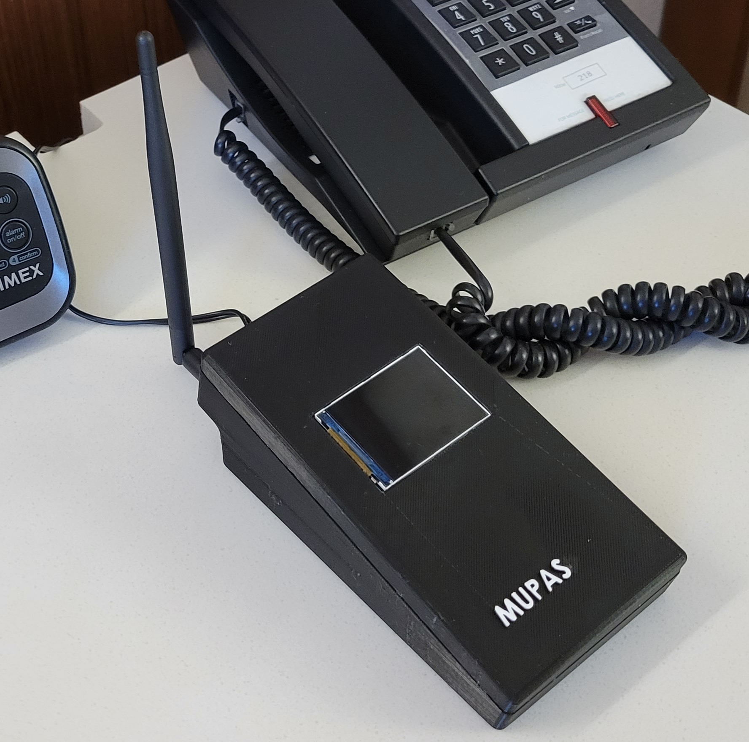
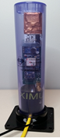
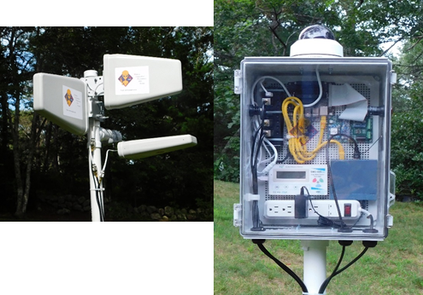
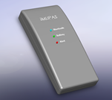
The Studies Current State of Technology
For the past four years, a study has been underway in the Uintah Basin to identify any strange signals associated with people’s observations of strange phenomenon. In order to measure these strange signals custom devices were fabricated called MUPAS for Modular Unidentified Phenomenon Alert System. MUPAS devices comes in three sizes, a personal model that fits in a pocket, two table models that can either be located in a home or lowered underground, and an outdoor model.
There are now over 37 MUPAS devices located thoughout the USA in the homes, workplaces, and properties of carefully selected particpants.

Slide 8
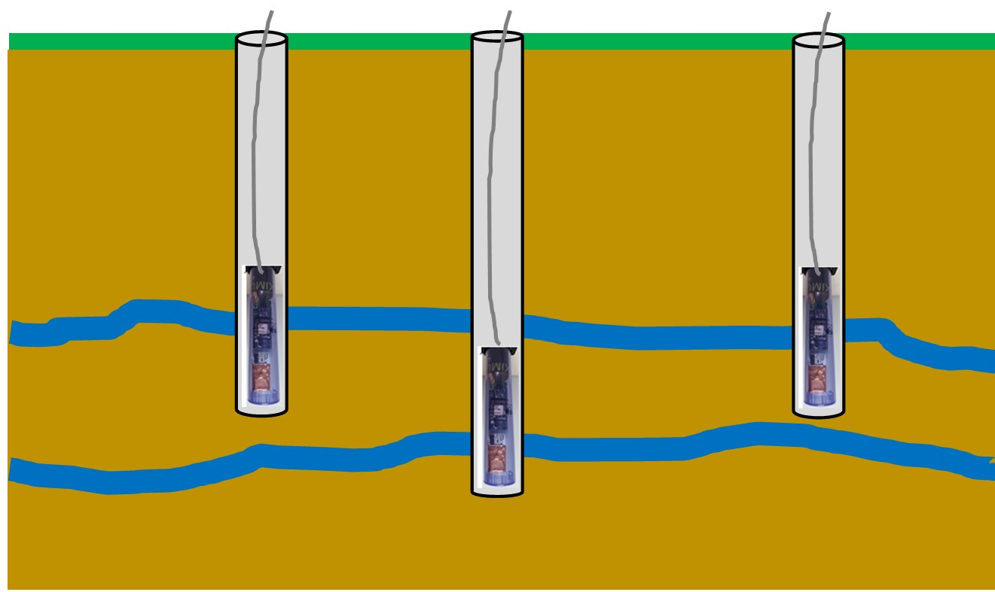
The Studies Current Activities
Question: Is there an energy source underneath the ground causing the injuries?
Solution: Detect transient subterranean energy sources using an array of MUPAS sensors.
Underground energy sources radiate RF signals and gamma rays.
MUPAS sensors can be lowered into drilled holes as deep as 1000’.
Three devices placed in separate drilled holes can be used to triangulate the signal and find its origin.

Slide 9
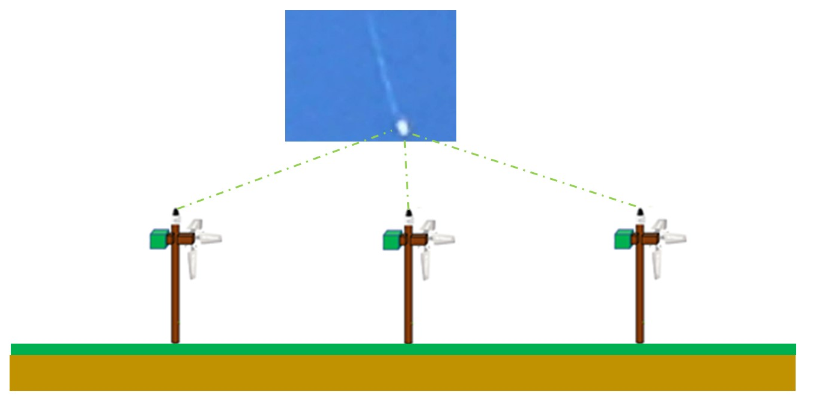
The Studies Current Activities
Question: Are UAP’s causing the strange events?
Solution: Track UAP’s using an array of MUPAS sensors to determine their speed and direction.
Photographs of UAP’s over the Uintah Basin are a common occurrence. No one has yet tracked a UAP and determined its speed and direction.
MUPAS sensors have cameras, pointed to the sky, that are programmed to track moving objects.
Three MUPAS devices at different points on the Ranch can triangulate the unidentified object to determine its speed and direction.
IR sensors located in the MUPAS device is used to determine the object's heat signature.

Slide 10
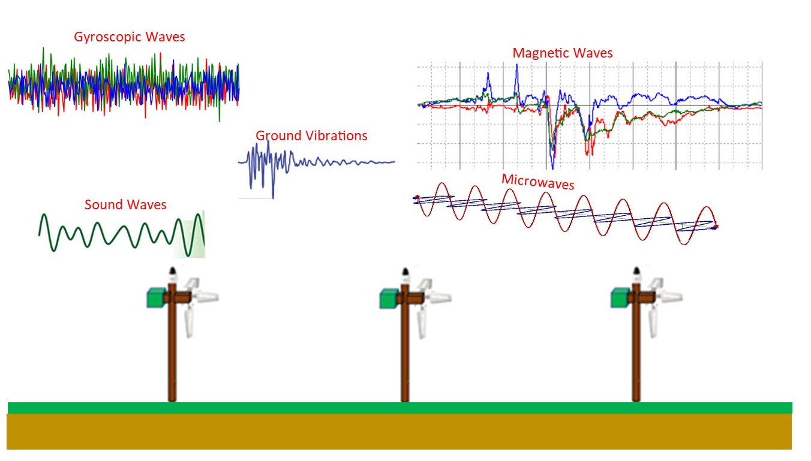
The Studies Current Activities
Question: Are there strange environmental signals in the Uintah basin
Solution: Track above ground environmental signals and correlating them with strange events using an array of MUPAS sensors.
Strange environmental signals are common in the Uintah basin.
MUPAS can record a wide variety of signals like RF, sound, ground vibrations, gamma rays, magnetic and gyroscopic waves.
When strange signals occur, there is significant evidence that normal brain activity can be affected.

Slide 11
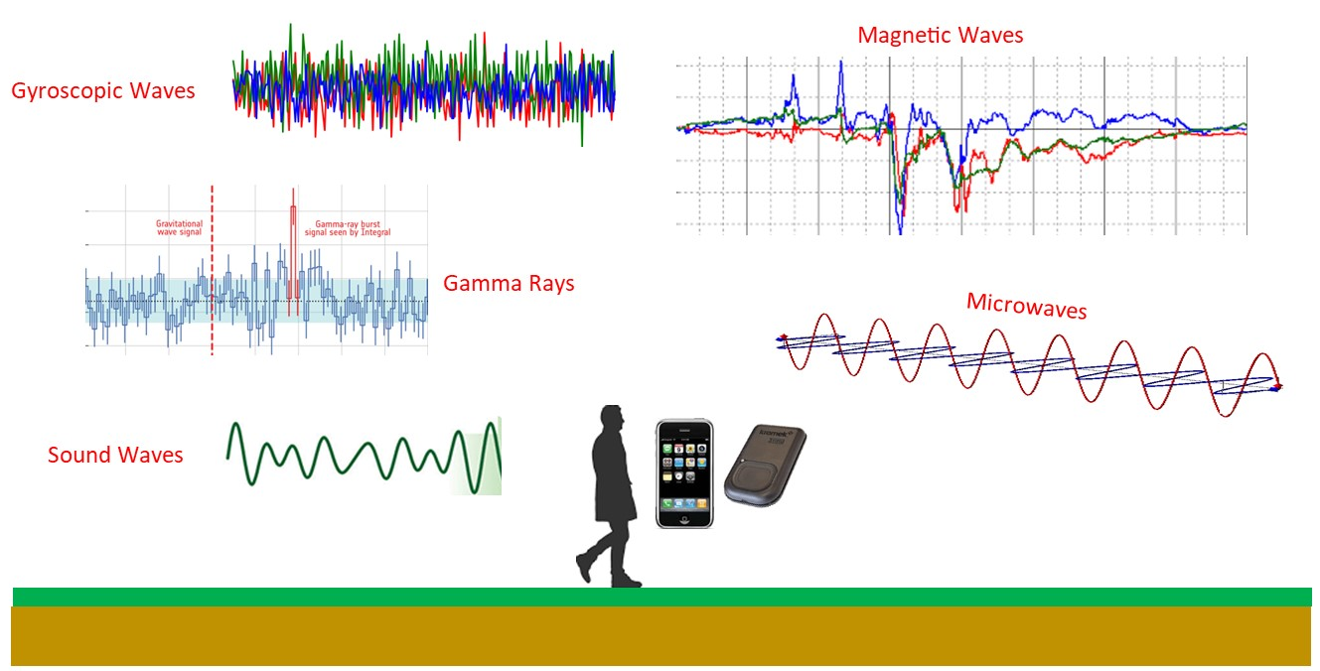
The Studies Current Activities
Question: Are people being targeted with strange signals?
Solution: Strange signals that affect human behavior and health can be tracked using a personal sized iMUPAS sensor.
Each person can be monitored to track strange signals that surround them. A personal sized iMUPAS can be worn in a pocket or attached to a belt.
The personal sized iMUPAS can record a wide variety of signals like RF, sound, gamma rays, magnetic and gyroscopic waves.
When strange signals occur, there is significant evidence that normal brain activity can be affected.

Slide 12
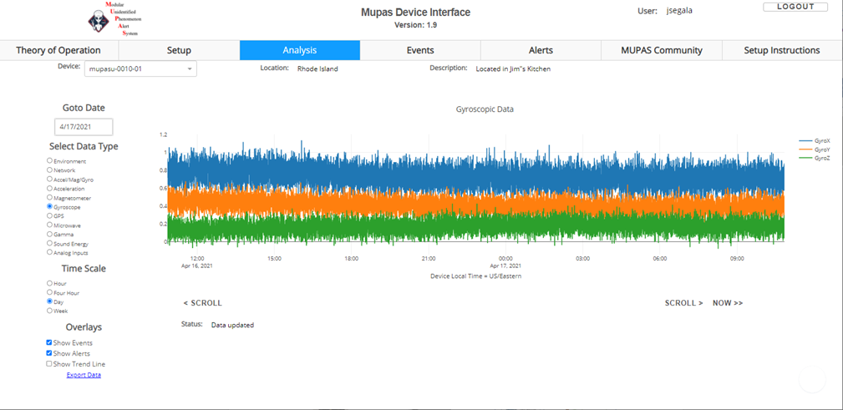
The Studies Current State of technology
All MUPAS devices send signal readings to a Cloud based server where the data is stored and analyzed.

Slide 13

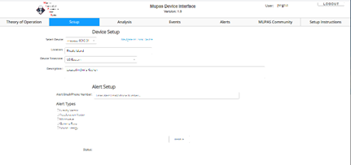
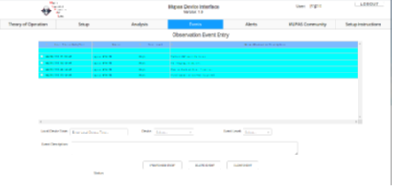
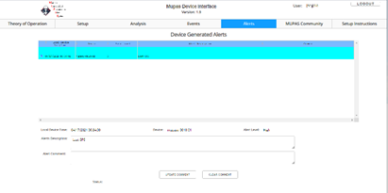
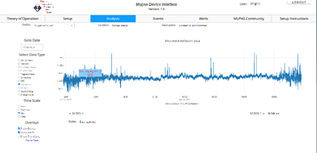
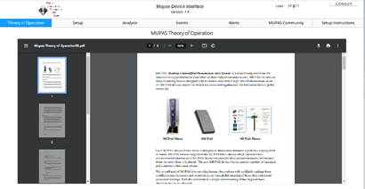
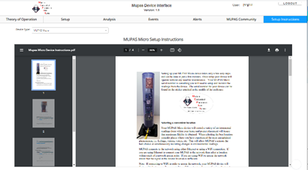
The Studies Current State of Technology
Members of the Study can view their data and other features of the MUPAS System from the MUPAS website. Members can also access all these features from their iMUPAS smartphone application for the Android and iPhone devices.

Slide 14
The Studies Community
Members of the Study can interact with each other and share experiences and data. This feature can be accessed from the MUPAS website or the iMUPAS smartphone application.
Discuss Experiences: Members of the study often have experiences with strange events that they would like to share with some or all other members of the study. Members can set up public or private chat rooms for these discussions and invite other members.
Share Data: Members sometimes come across data from their MUPAS devices that they would like to share with other members. Data sharing can be done for specified time spans and data types between members.
Community Notices: Members often have suggestions they would like to share with some or all the other members of the study. This is done using the bulletin board feature where notices can be posted.

Slide 15
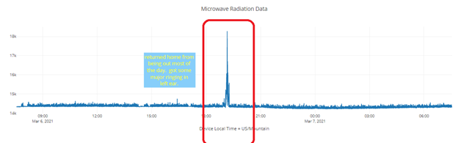
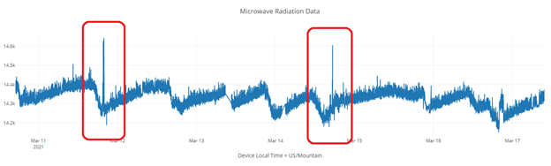
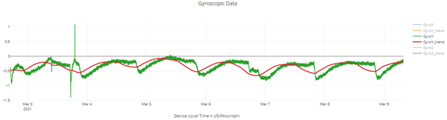
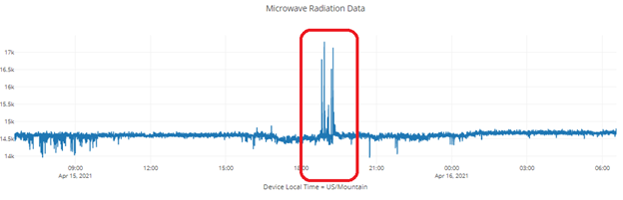
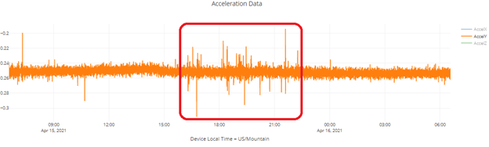
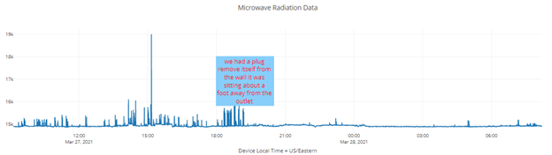
The Studies Findings
Many anomalous signals have been recorded by the recording devices. Most of the events were correlated with an observation made by the participant.

Slide 16
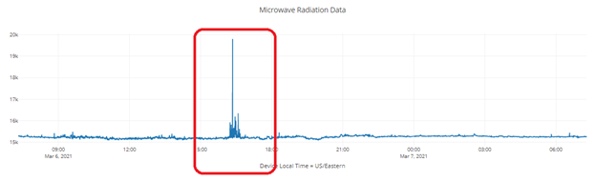
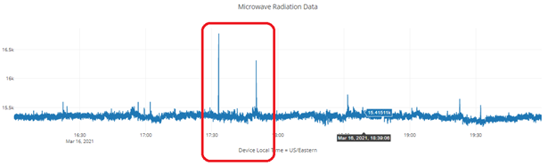
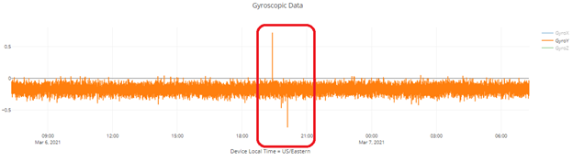
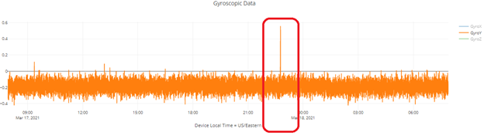
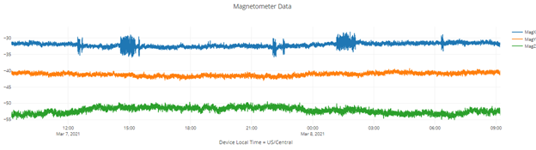
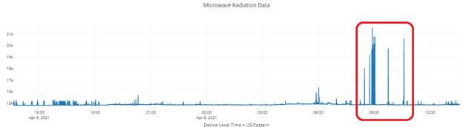
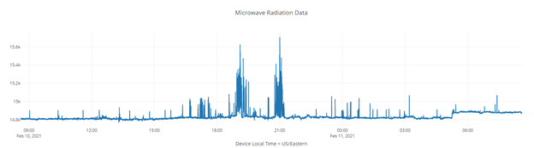
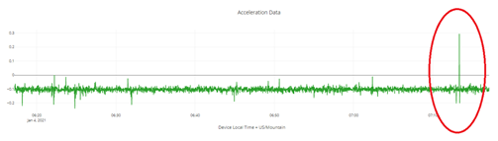
The Studies Findings

Slide 17
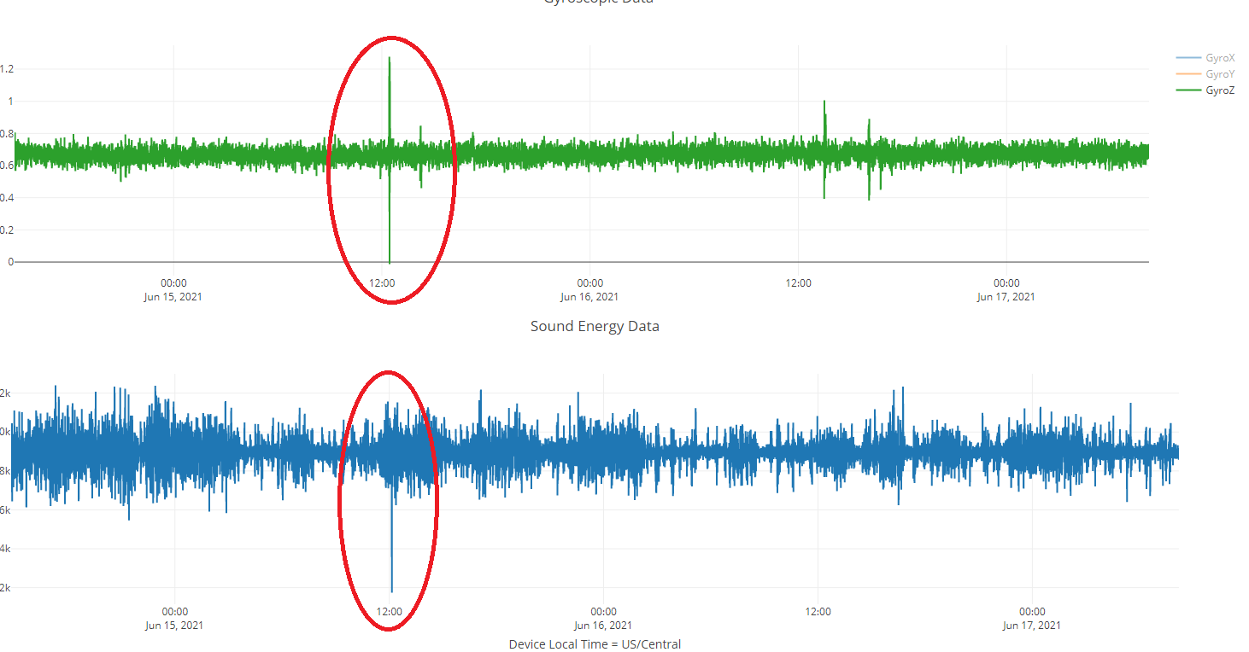
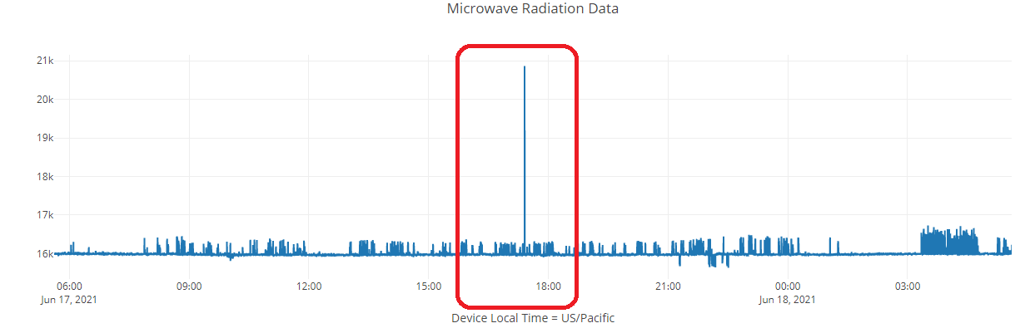
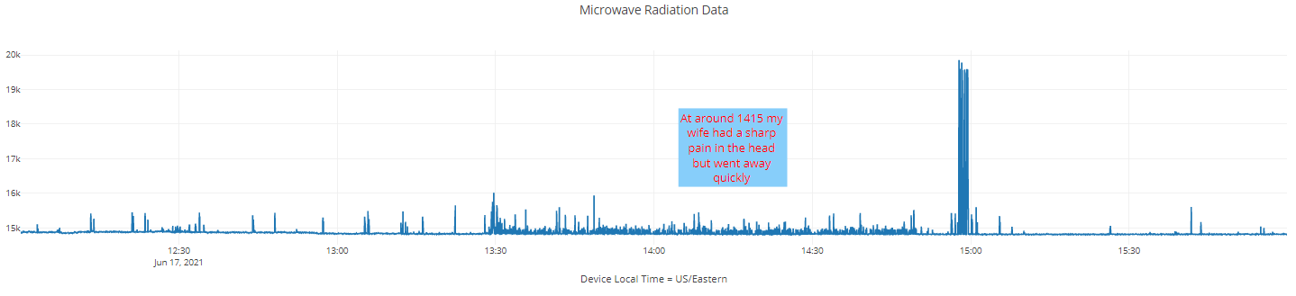
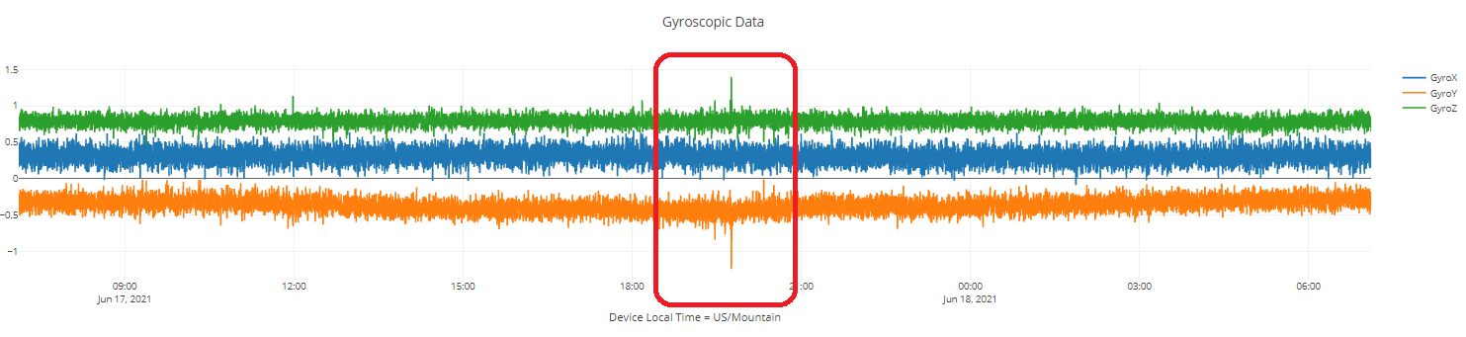
The Studies Findings

Slide 18
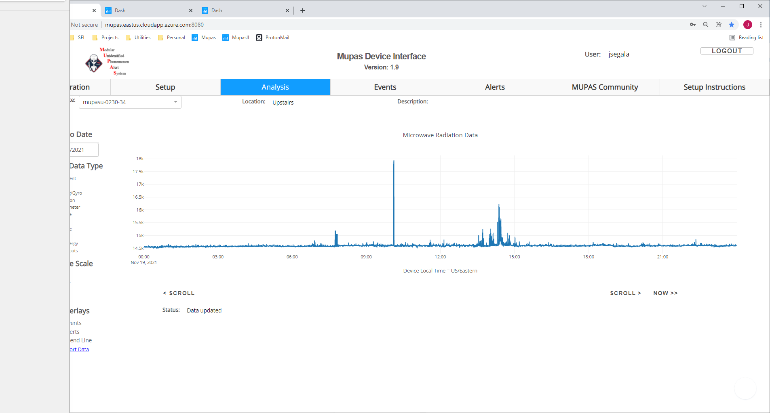
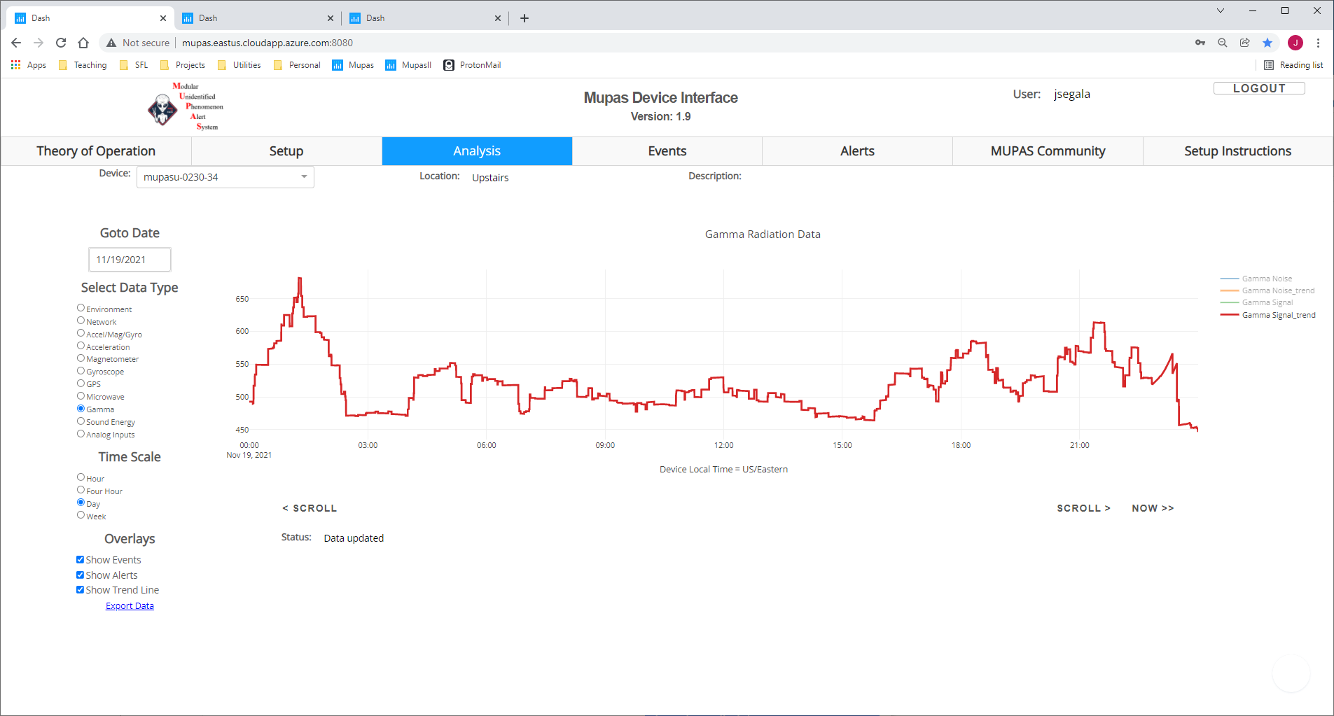
Case Study: 233 Device: mupasu-0230-34
Microwave Channel Data:
Gamma Particle Rate Channel:

Slide 19
Case Study: 233 Device: mupasu-0230-34
Case Overview:
Between 00:30 and 2:23 a large flux of gamma particles was recorded peeking at 01:14.
In comparison to the average gamma particle rates for this device, this event has a 5 times larger gamma peek rate during the interval.
At 10:06 a large microwave spike was found that exceeds the mean microwave amplitude historically found for this device by a factor of 35. The spike consisted of three separate spikes at 45 second intervals totaling approximately 1 minute in duration. The duration of the individual spikes was between 100 microseconds and 1 millisecond.
The magnitude and character of the microwave readings for this event far exceed the typical household microwave signals.

Slide 20
Case Study: 233 Device: mupasu-0230-34
Reported Observations
Interrupted sleep the evening before with bad dreams.
Headaches reported by all occupants during the night and as they awoke.
After 10:00 two people in the house reported migraine level headaches. One person experienced a severe nosebleed.
Ringing in the ears started in the afternoon.
Symptoms persisted until the 18:00 with everything back to normal.
Follow-up
Data presented to the participant a week later.
A report was generated and provided to the participant, the FBI, and NCIS.

Slide 21
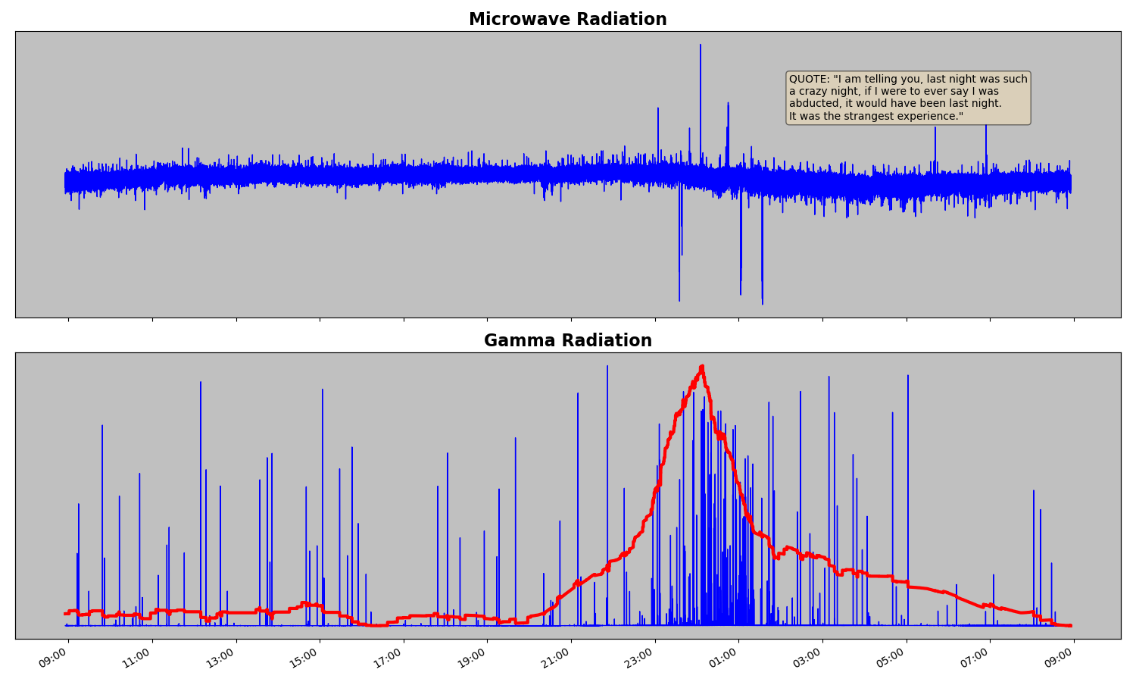
Case Study: 316 Device: mupasu-0243-22

Slide 22
Case Study: 316 Device: mupasu-0243-22
Case Overview:
Between 22:00 and 3:00 a large flux of gamma particles was recorded peeking at 23:22.
In comparison to the average gamma particle rates for this device, this event has a 22 times larger gamma peek rate during the interval.
At 0:35 large microwave spikes occurred that exceeds the mean microwave amplitude historically found for this device by a factor of 10. The spikes occurred approximately every 15 minutes during the gamma rate peek. The duration of the individual spikes was between 100 microseconds and 1 millisecond.
The magnitude and character of the microwave readings for this event far exceed the typical household microwave signals.

Slide 23
Case Study: 316 Device: mupasu-0243-22
Reported Observations
Interrupted sleep starting after midnight.
Felt disorientated, confused.
Commented the next day: “If I were ever to say I was abducted, it would have been last night.”
Follow-up
Data presented to the participant a week later.
A report was generated and provided to the participant.

Slide 24
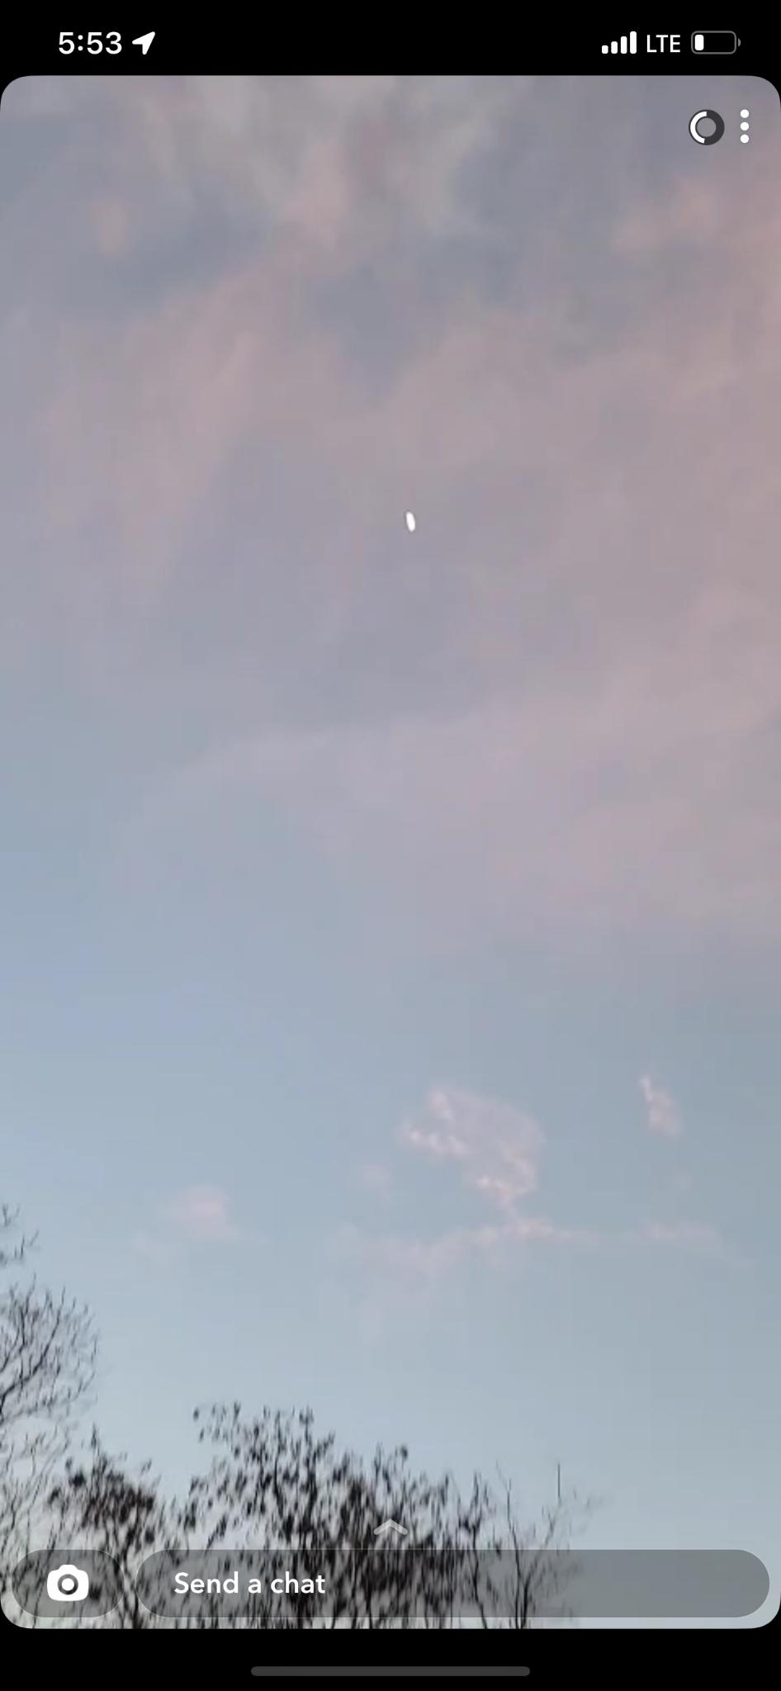
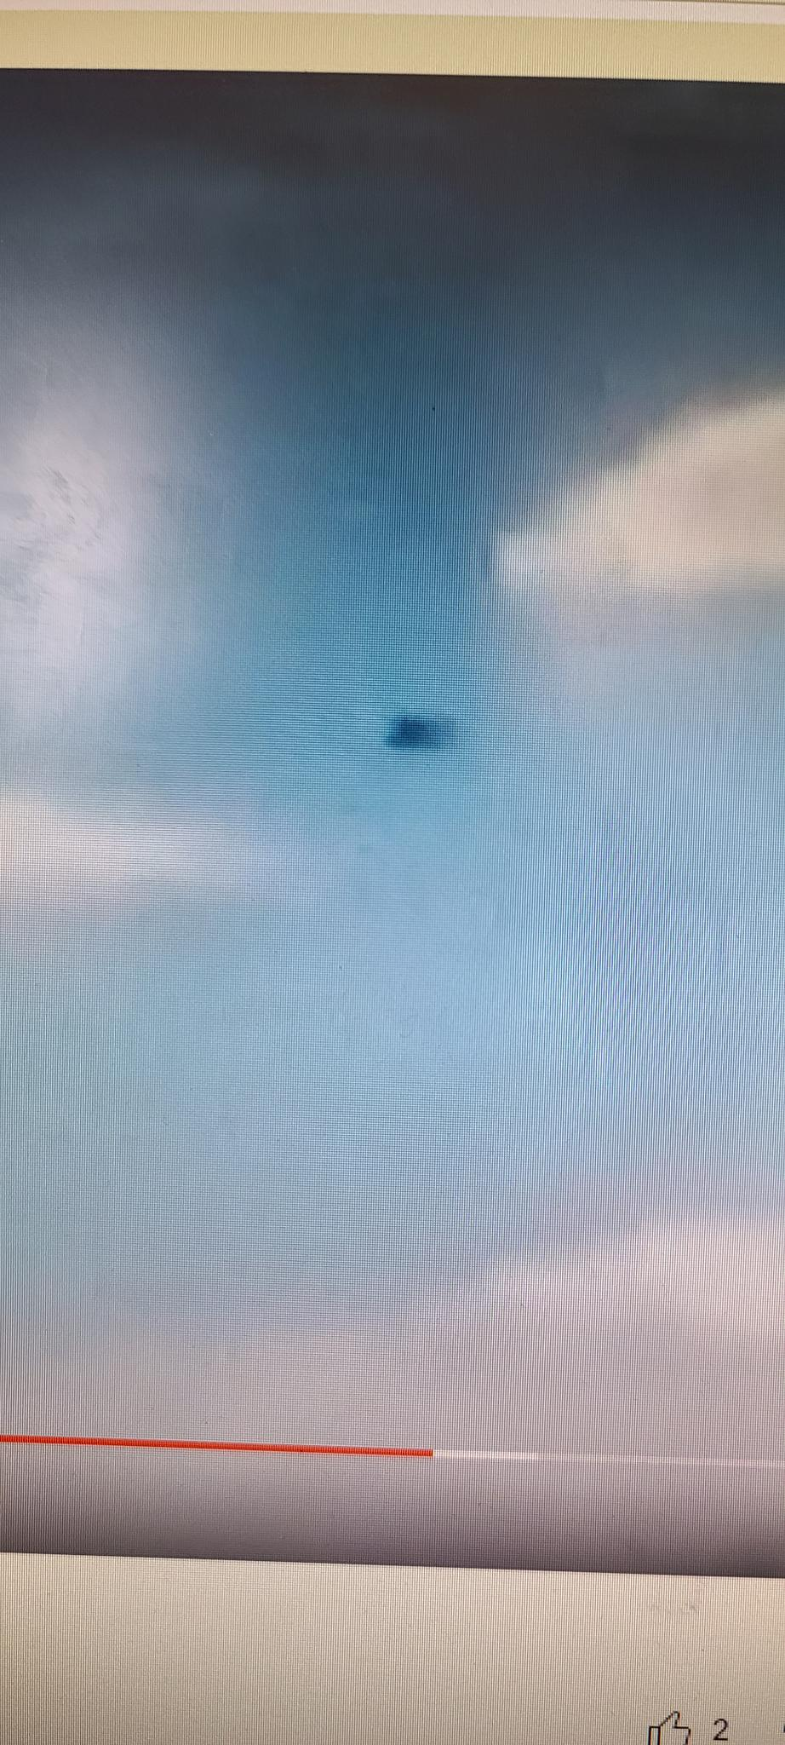
Unidentified Aerial Phenomenon Correlations
During interactions with the phenomenon, observations of UAP have been reported.
Many sightings of UAP’s have been made when participants experience interactions with the phenomenon.
When dogs are nearby, UAP sightings typically make dogs react by barking.

Slide 25

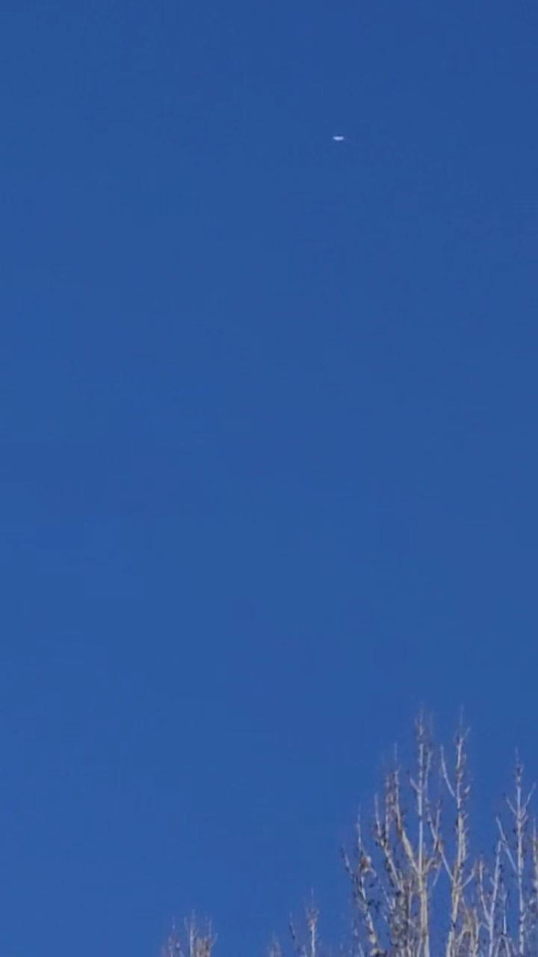
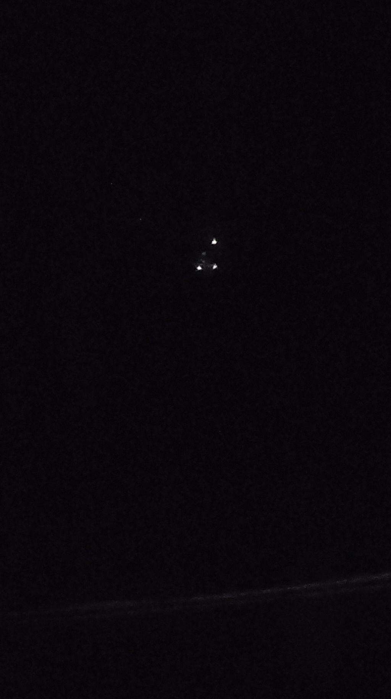
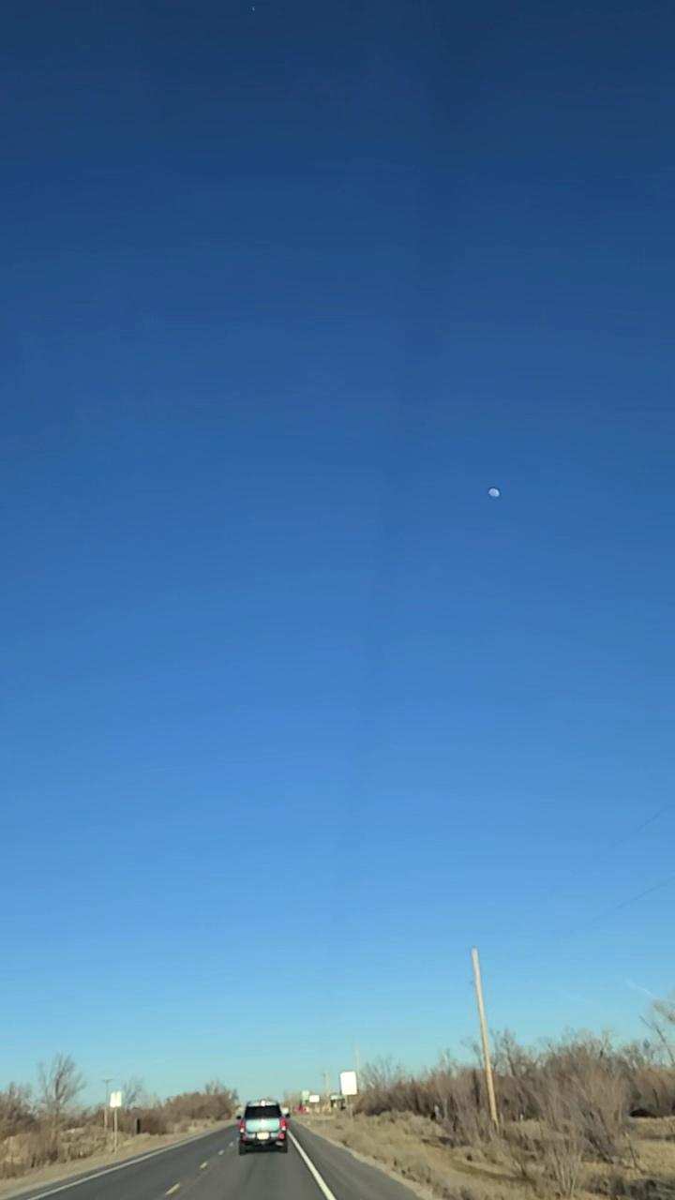
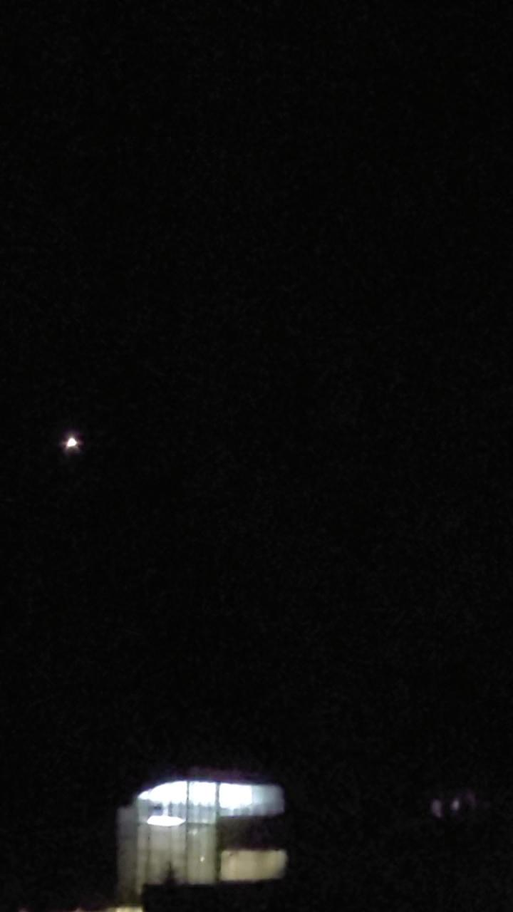
Unidentified Aerial Phenomenon Correlations

